Slide 1
Weak Slot-and-Filler Structures
Index assertions by the entities they describe.
Make it easy to describe properties of relations.
Are a form of object-oriented programming.
Support both monotonic and Nonmonotonic inference.

Slide 2
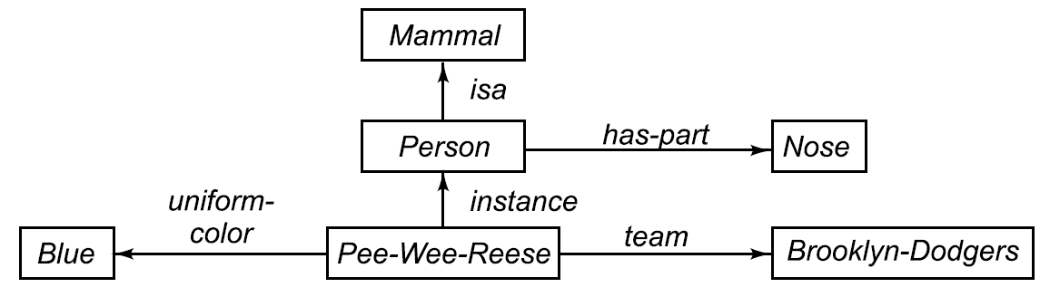
A Semantic Network

Slide 3

Representing Nonbinary Predicates
Unary Predicates can be rewritten as binary ones.
could be rewritten as
N-Place Predicates
becomes

Slide 4
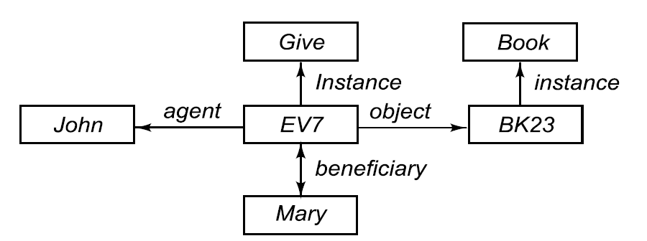
A Semantic Net Representing a Sentence
“John gave the book to Mary.”

Slide 5
Some Important Distinctions
First try :
Second try :
Third try :

Slide 6
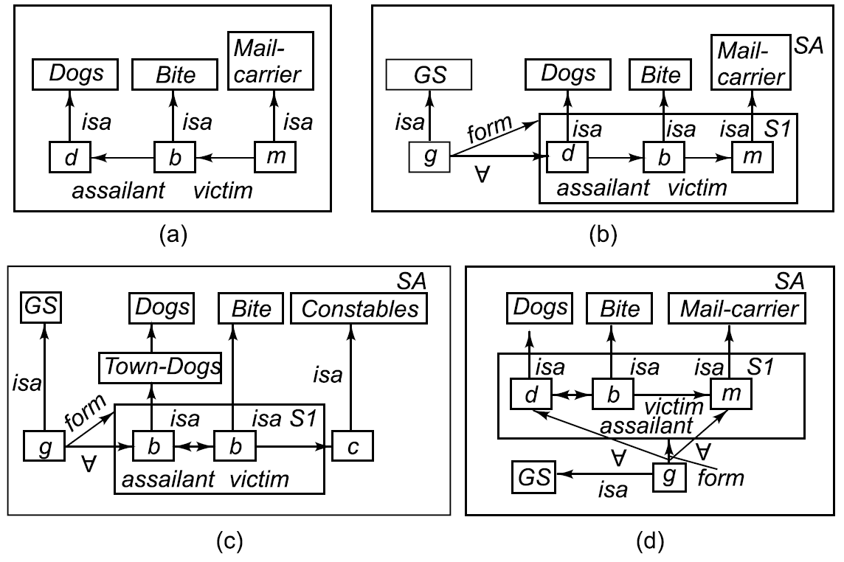
Partitioned Semantic Nets
The dog bit the mail carrier.
Every dog has bitten a mail carrier.
Every dog in town has bitten the constable.
Every dog has bitten every mail carrier.

Slide 7
A Simplified Frame System

Slide 8
A Simplified Frame System (Cont’d)

Slide 9
A Simplified Frame System (Cont’d)

Slide 10
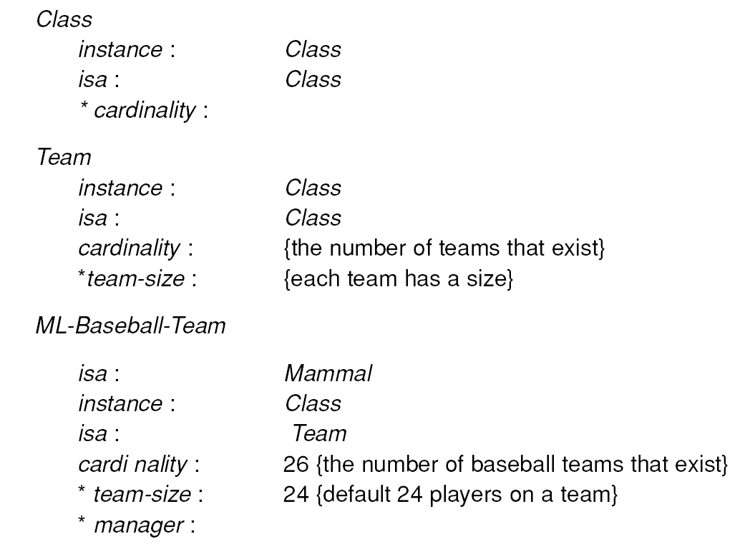
Representing the Class of All Teams as a Meta Class

Slide 11
Representing the Class of All Teams as a Meta Class (Cont’d)

Slide 12
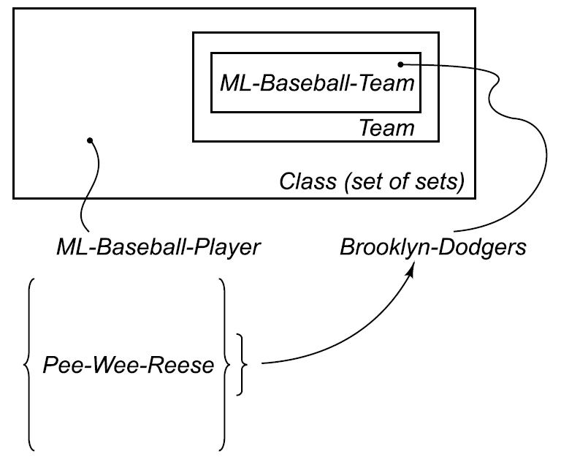
Classes and Metaclasses

Slide 13
Representing Relationships among Classes

Slide 14
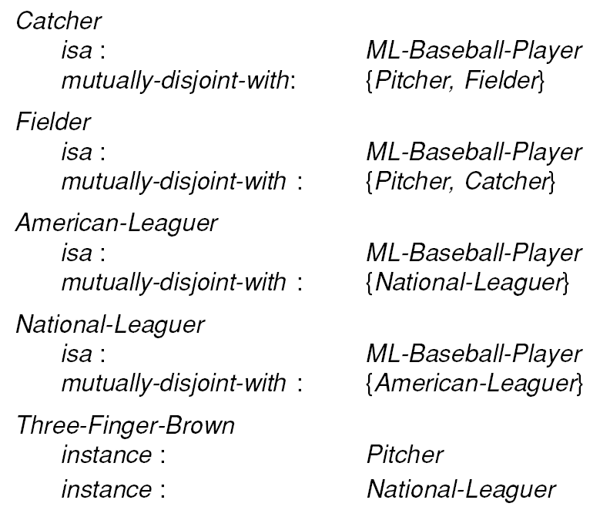
Representing Relationships among Classes (Cont’d)

Slide 15
Slots as Full – Fledged Objects
We want to be able to represent and use the following properties of slots (attributes or relations) :
The classes to which the attribute can be attached.
Constraints to either the type or the value of the attribute.
A value that all instances of a class must have by the definition of the class.
A default value for the attribute.
Rules for inheriting values for the attribute.
Rules for computing a value separately from inheritance.
An inverse attribute.
Whether the slot is single-valued or multi-valued.

Slide 16
Multiple Choice Single Answer
Representing Slots as Frames, I

Slide 17
Representing Slots as Frames, II

Slide 18
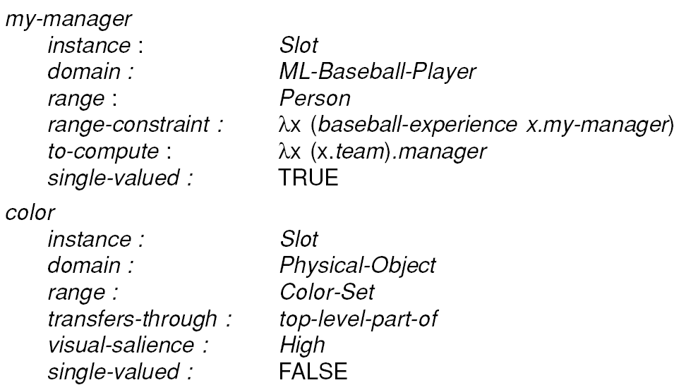
Representing Slots as Frames, III

Slide 19
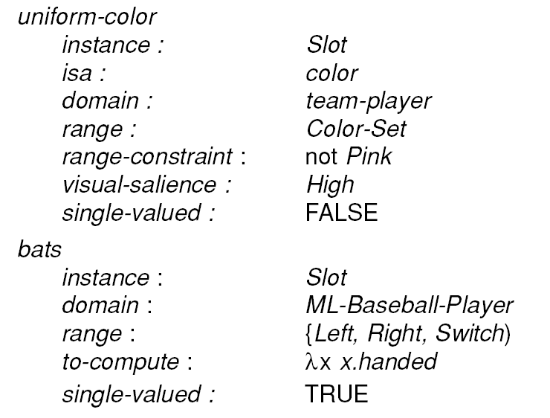
Representing Slots as Frames, IV

Slide 20
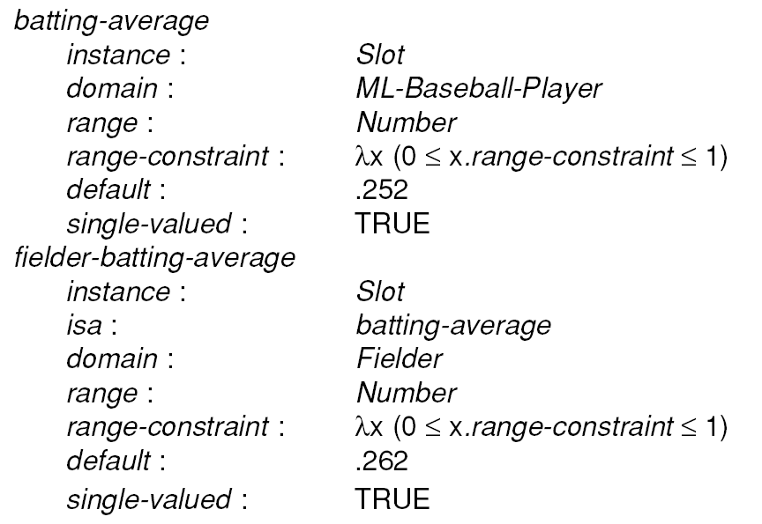
Associating Defaults with Slots

Slide 21
A Shorthand Notation for
slot-Range Specification

Slide 22
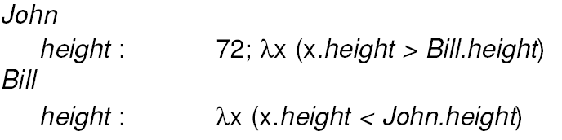
Representing Slot - Values
As simple frames :
Using Lambda Notation :

Slide 23
Tangled Hierarchies

Slide 24
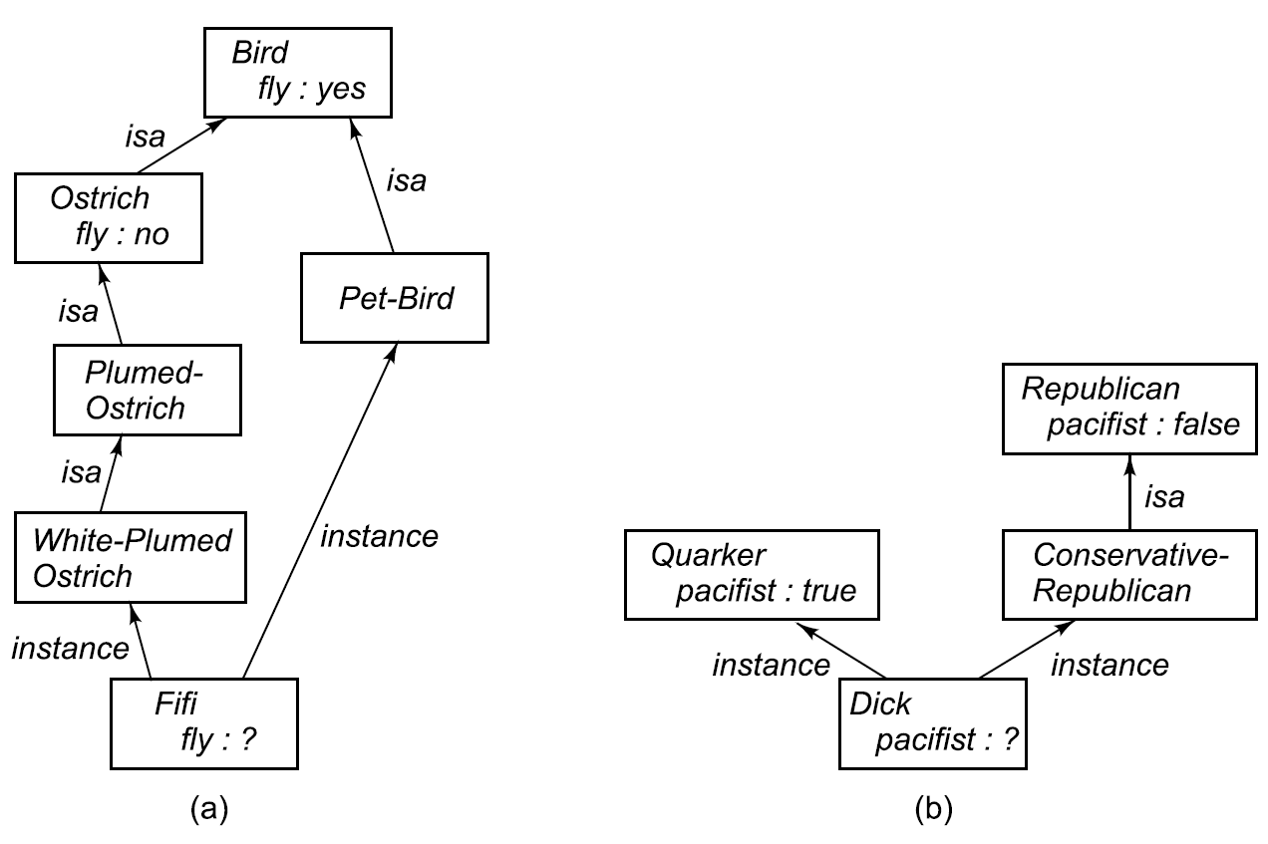
More Tangled Hierarchies

Slide 25
Defining Property Inheritance
Inferential Distance :
Class1 is closer to Class2 than to Class3, if and only if Class1 has an inference path through Class2 to Class3 (in other words, Class2 is between Class1 and Class3).
We can now define the result of inheritance as follows: The set of competing values for a slot S in a frame F contains all those values that
• Can be derived from some frame X that is above F in the
isa hierarchy
• Are not contradicted by some frame Y that has a
shorter inferential distance to F than X does

Slide 26
Algorithm : Property Inheritance
To retrieve a value V for slot S of an instance F do:
1. Set CANDIDATES to empty.
2. Do breadth-first or depth-first search up the isa hierarchy from F, following all instance and isa links. At each step, see if a value for S or one f its generalizations is stored.
(a) If a value is found, add it to CANDIDATES and terminate that branch of the search.
(b) If no value is found but there are instance or isa links upward, follow them.
(c) Otherwise, terminate the branch.
3. For each element C of CANDIDATES do:
(a) See if there is any other element of CANDIDATES that was derived from a class closer to F than
the class from which C came.
(b) If there is, then, remove C from CANDIDATES.
4. Check the cardinality of CANDIDATES:
(a) If it is 0, then report that no value was found.
(b) If it is 1, then return the single element of CANDIDATES as V.
(c) If it is greater than 1, report a contradiction.

